Slide 2
Neural Networks
Yanxi Pan

Slide 3
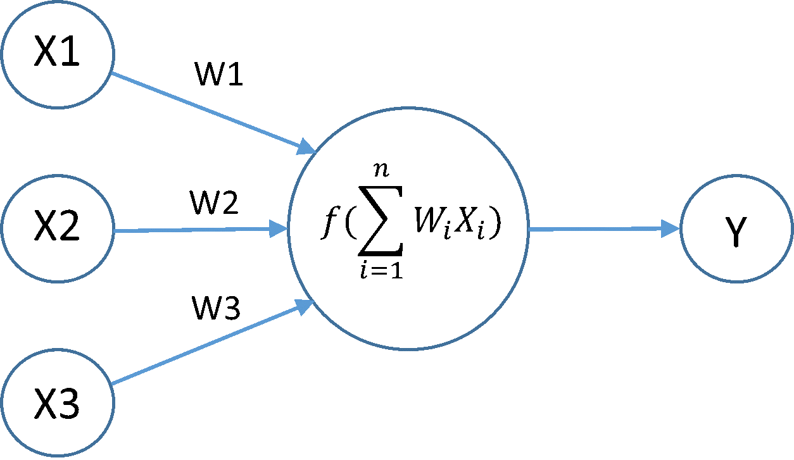
Neural Nets
Inspired by how the brain works
Each neuron takes several inputs and produces an output
f() is the activation function

Slide 4
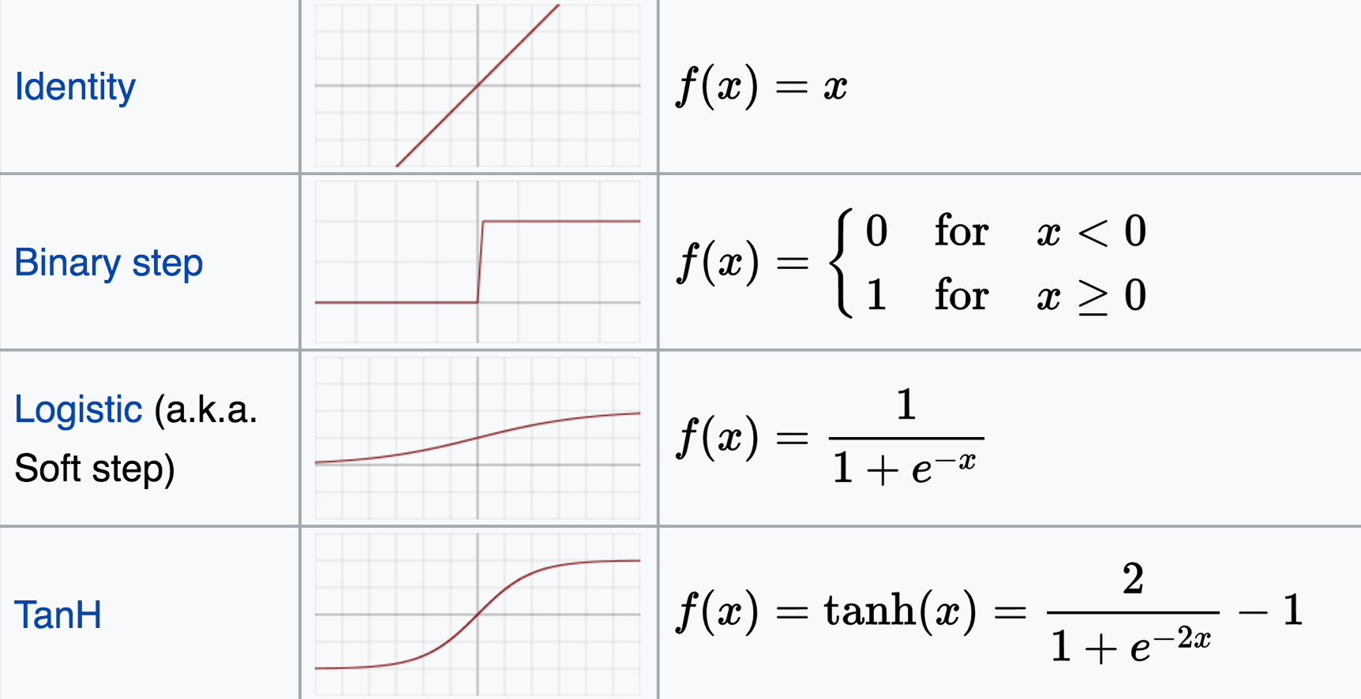
Activation Functions

Slide 5
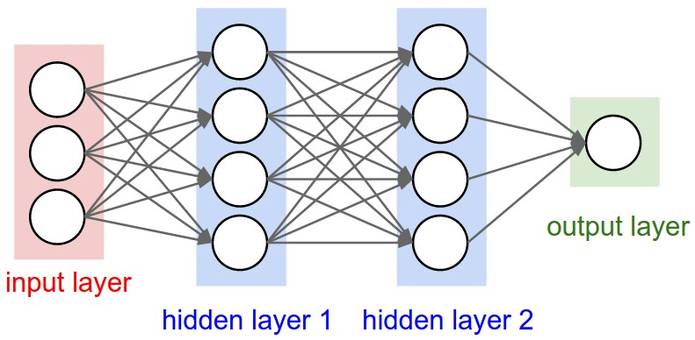
Neural Networks
Many neurons connect together and become network
Representation power: NN with 1 hidden layer can approximate any bounded continuous function (Universal Approximation Theorem)

Slide 6
How does neural network learn?
Backpropagation
Phase 1: For each input example, get the output by forward propagation. Compute an error and propagate it backwards to all the layers.
Phase 2: Compute the gradient of loss function for each neuron based on the error in phase 1. Update weights according to the gradient.

Slide 7
Applications
Computer vision
Photo filter and transformer
Speech recognition
Voice commands on the phone

